Slide 1
Longitudinal Analysis of the Effect of Maternal Immune Activation on Male Offspring Rhesus Monkeys in Human Intruder Test
Presenter: Min Kim
Graduate Group in Biostatistics, UC Davis

Slide 2
Topics
Introduction
Data
Exploratory Analysis
Modeling
Results
Conclusion

Slide 3
Introduction: Maternal Immune Activation Model
Maternal immune activation (MIA) models of rodents and non-human primates have shown their powerful and translational utility to extended exploration of neurobiological mechanisms underlying human neurodevelopmental disorders (Kentner, 2019).
MIA models use the viral mimic immunostimulant, Polyinosinic: polycytidylic acid stabilized with poly-L-lysine(Poly ICLC), to elicit an immune response during gestation.

Slide 4
Study: MIA model on Rhesus Monkeys
Current ongoing study on 28 male offspring of rhesus monkeys from MIA-treated (Poly ICLC treated) (n = 14), saline (n = 10), or untreated (n = 4) dams.
Human Intruder Test (HI Test) to assess the responsiveness of male offspring rhesus monkeys to the standardized conditions of a human intruder.

Slide 5
Human Intruder Test (HI Test)
Human Intruder Test
14 MIA-treated and 14 control male offspring rhesus monkey tested approximately at 1, 3, 6, 23, and 35 months of age
A session of 4 one-min trials of a human intruder’s 4 conditions:
Each of the 4 conditions is scored as duration.
1. Profile Far (1 min)
Human Intruder positioning:
2.Profile Near (1 min)
1,2,3,4 Duration Recorded
3.Stare Far (1 min)
4.Stare Near (1 min)

Slide 6
Study Question
The scientific interest is to see whether there is a difference in “Front” duration under conditions: “Profile” and “Stare” between the group of male offspring rhesus monkeys of MIA-treated and control dams

Slide 7
Data: Human Intruder Positioning Data
36 total variables and attributes for 5 time points observations of 28 animals Defining outcome:
Profile Front Duration: Average of Profile Far and Near
Stare Front Duration: Average of Stare Far and Near
Predictors:
Actual age of animals at each time point
Treatment group (MIA vs. Control)
Missing Data

Slide 8
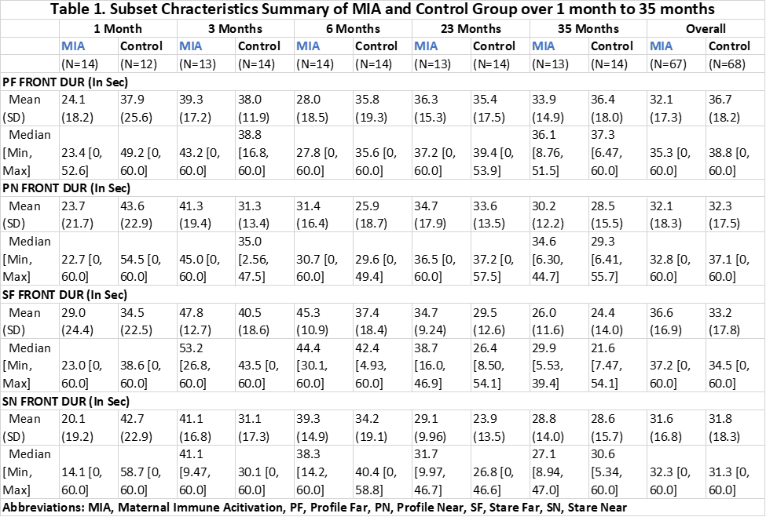
Descriptive Summary

Slide 9
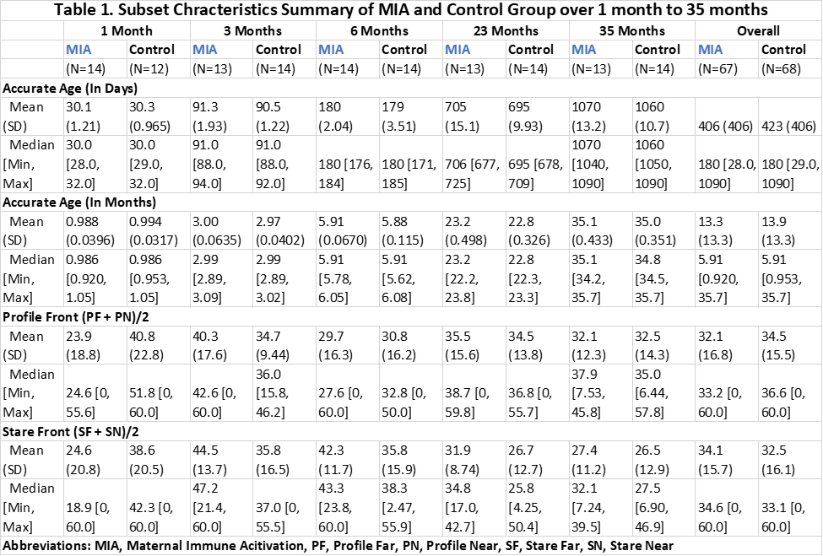
Outcome 1
Outcome 2

Slide 10
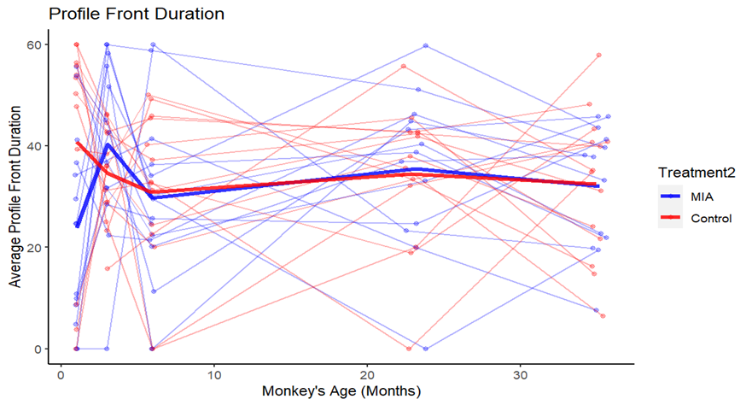
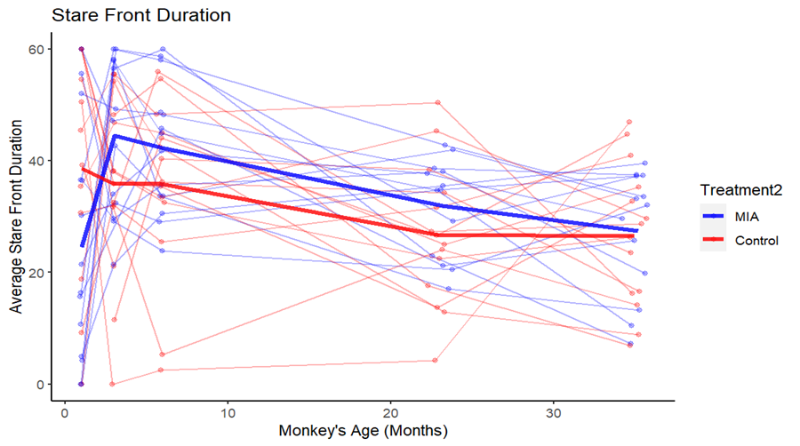
Exploratory Data Analysis

Slide 11
Method
Modeling for outcome: Front duration in 2 conditions: Profile and Stare
Linear Mixed Effect Model
Model Selection
Assessment of Treatment Effect

Slide 12
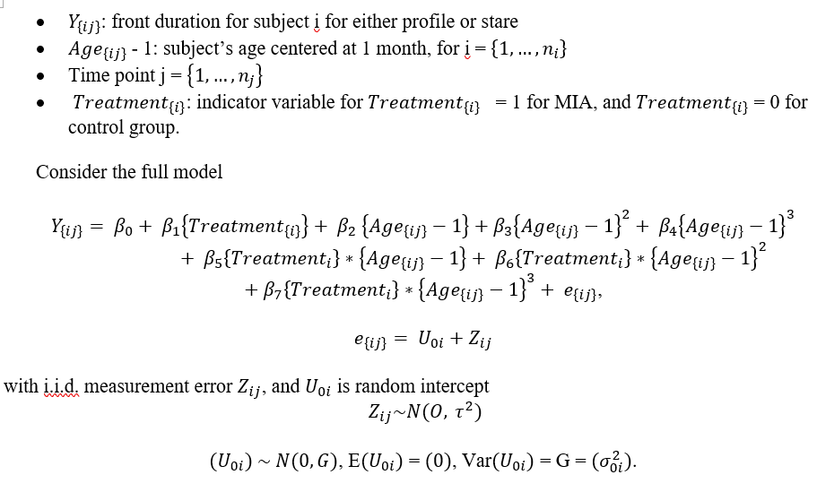
Initial Model: Linear Mixed-Effect Model (ReML)

Slide 13
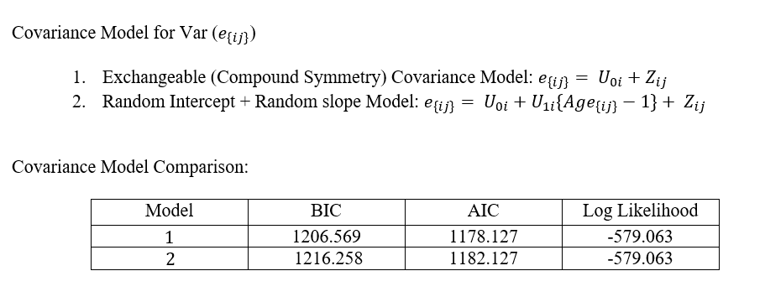
Modeling: Profile Front Duration
Final Covariance Model: Exchangeable (Compound Symmetry) Covariance Model

Slide 14
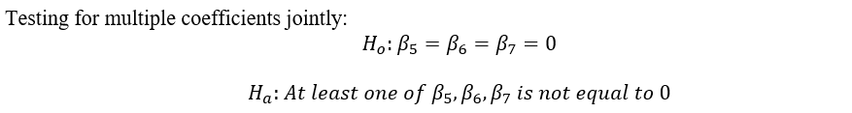
Modeling Mean Model: Profile Front Duration
Initial fitting of mean model with exchangeable covariance model
Multiple testing for all interaction terms
Sequentially test higher order “Age” effects while always keep treatment and linear age effect in the model (t-test)
Decide on final model

Slide 15
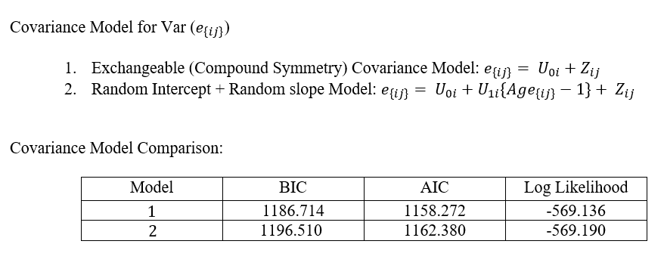
Modeling Stare Front Duration
Final Covariance Model: Exchangeable (Compound Symmetry) Covariance Model

Slide 16
Modeling Mean Model: Stare Front Duration
Initial fitting of mean model with exchangeable covariance model
Multiple testing for all interaction terms
Sequentially test higher order “Age” effects: while always keep treatment and linear age effect in the model (t-test)
Decide on final model

Slide 17
Model Selection
Both Profile and Stare Front duration:
All age interaction terms are not significant
Profile: cubic, quadratic age are dropped by t-test
Stare: cubic, quadratic age are not dropped by t-test
Full Model vs. Model without all interaction terms | Profile Model | Stare Model
F-Statistic | 1.319 | 1.860
P-value | 0.272 | 0.073

Slide 18
Results: Final Model
Profile Front Duration
Stare Front Duration

Slide 19
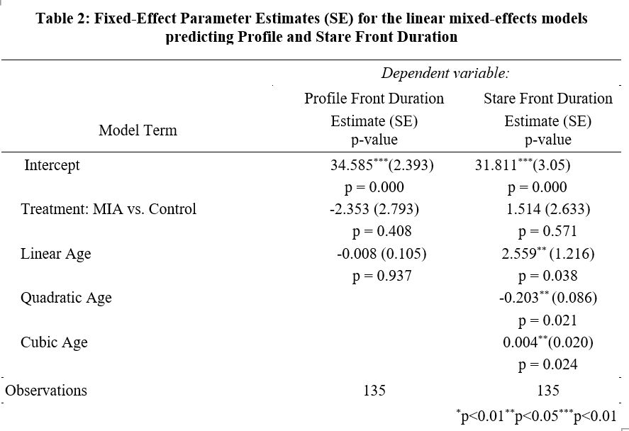
Results: Final Model

Slide 20
Results: Final Model (continued)
No interaction of treatment and age are significant (profile: p= 0.2722758, stare: p = 0.0728028)
Effect of treatment on front duration is not significantly different over time
Profile (est. = -2.353, p = 0.408), Stare (est. = 1.514, p= 0.571)
Effect of age on front duration is not significantly different across MIA and control group with linear age not significant for profile front duration (est. = -0.008, p = 0.937) and linear, quadratic, cubic age significant for stare front duration (est. = 2.559, p = 0.038, est = -0.203, = 0.021, est = 0.004, p = 0.024, respectively).

Slide 21
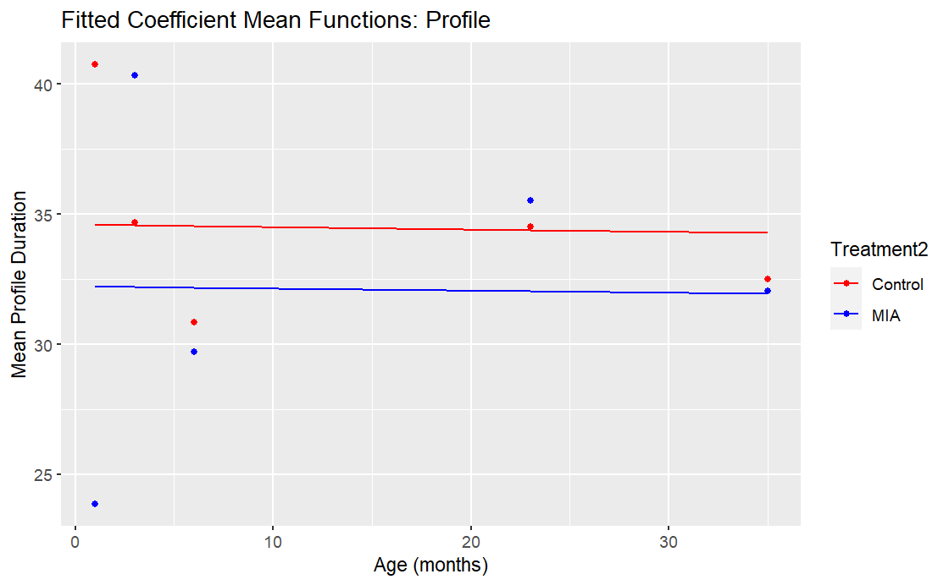
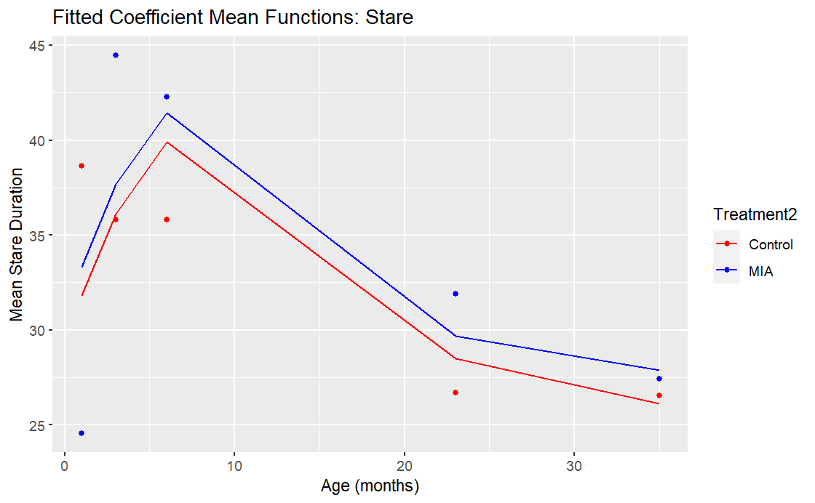
Model Diagnostics

Slide 22
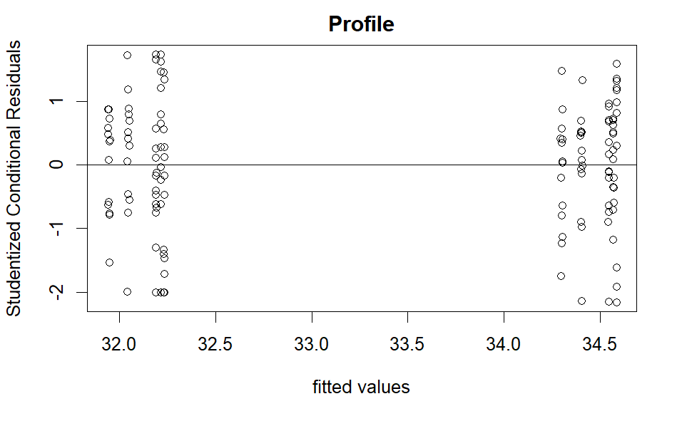
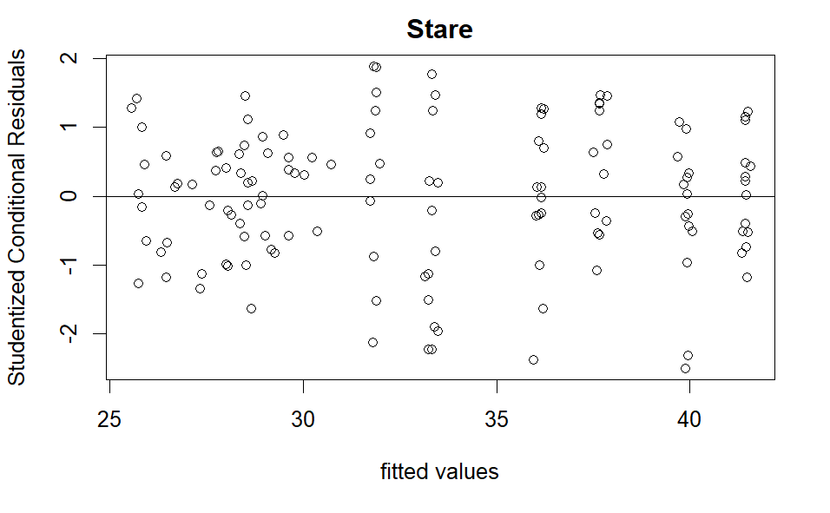
Model Diagnostics: Conditional Residual Analysis

Slide 23
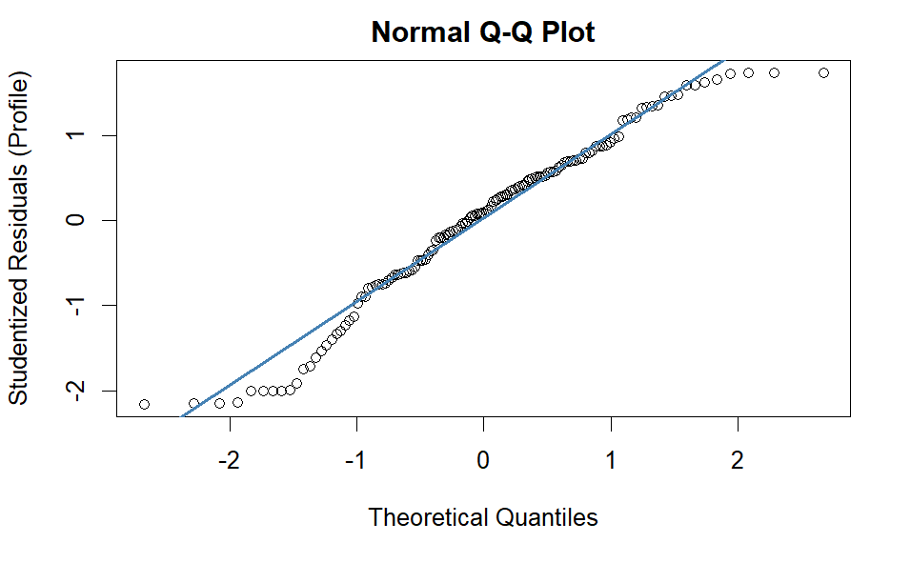
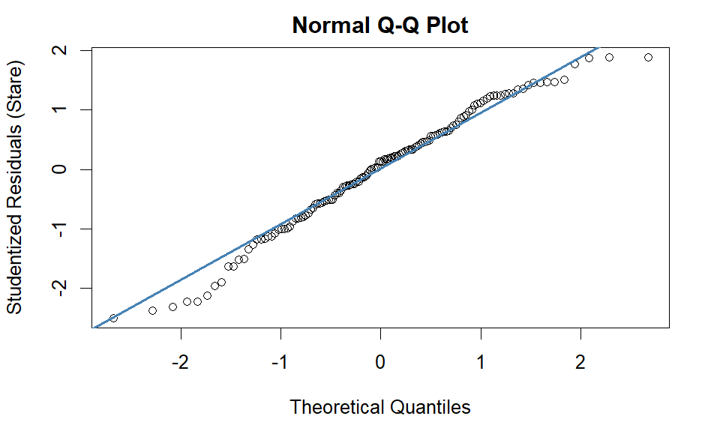
Model Diagnostics: Conditional Residual Analysis

Slide 24
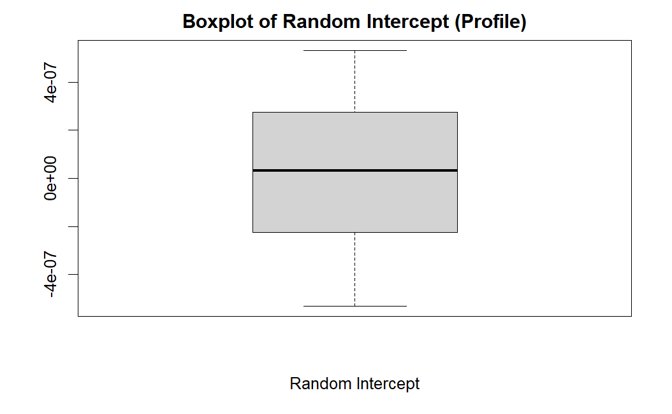
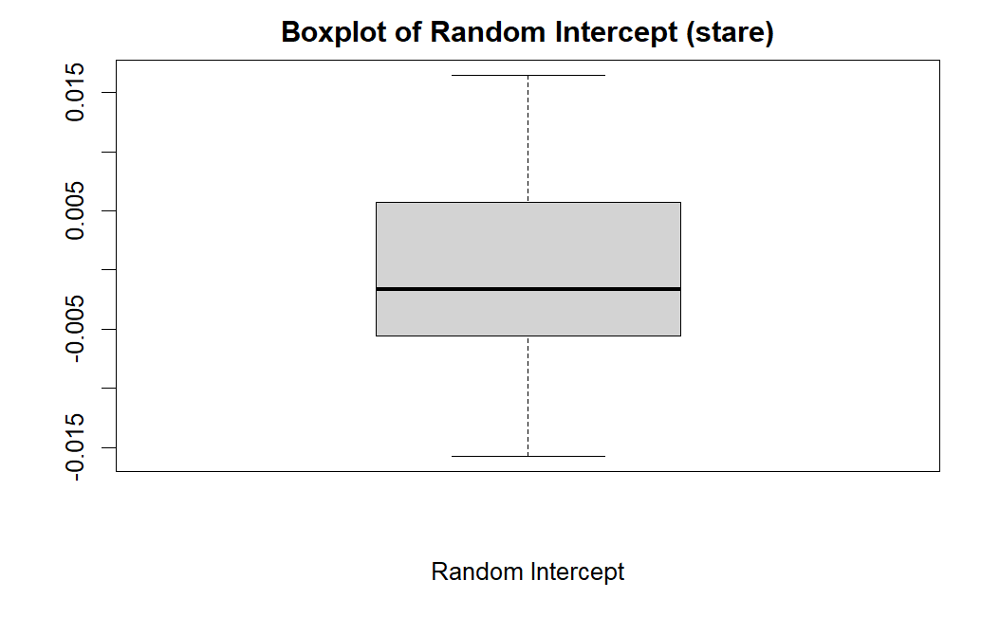
Model Diagnostics: Random Intercept

Slide 25
Conclusion
Treatment effect is not different over time for profile and stare conditions.
Age effect is not different across treatment group for profile and stare conditions.
MIA and control group perform similarly on “Front” duration on human intruder’s conditions.
Possible future investigation on other outcome measures of the HI test
Frequency of position change
Frequency of various types of behaviors

Slide 26
References
Bauman, M. D., A. M. Iosif, S. E. Smith, C. Bregere, D. G. Amaral and P. H. Patterson (2014). "Activation of the maternal immune system during pregnancy alters behavioral development of rhesus monkey offspring." Biol Psychiatry 75(4): 332-341.
Gottlieb DH, Capitanio JP. “Latent variables affecting behavioral response to the human intruder test in infant rhesus macaques (Macaca mulatta).” Am J Primatol. 2013 Apr;75(4):314-23. doi: 10.1002/ajp.22107. Epub 2012 Dec 10. PMID: 23229557; PMCID: PMC3581725.
Kentner AC, Bilbo SD, Brown AS, Hsiao EY, McAllister AK, Meyer U, Pearce BD, Pletnikov MV, Yolken RH, Bauman MD. “Maternal immune activation: reporting guidelines to improve the rigor, reproducibility, and transparency of the model.” Neuropsychopharmacology. 2019 Jan;44(2):245-258. doi: 10.1038/s41386-018-0185-7. Epub 2018 Aug 21. PMID: 30188509; PMCID: PMC6300528.
Vlasova RM, Iosif AM, Ryan AM, Funk LH, Murai T, Chen S, Lesh TA, Rowland DJ, Bennett J, Hogrefe CE, Maddock RJ, Gandal MJ, Geschwind DH, Schumann CM, Van de Water J, McAllister AK, Carter CS, Styner MA, Amaral DG, Bauman MD. “Maternal Immune Activation during Pregnancy Alters Postnatal Brain Growth and Cognitive Development in Nonhuman Primate Offspring.” J Neurosci. 2021 Dec 1;41(48):9971-9987. doi: 10.1523/JNEUROSCI.0378-21.2021. Epub 2021 Oct 4. PMID: 34607967; PMCID: PMC8638691.

